Slide 1
Ecommerce Capstone Project (Mid Submission)
Group Members:
Merin Jose
Suresh Balla
Deepak Aneja
Fayiz Mayam Veettil
21 Oct 2018

Slide 2
Table of Contents
Business Understanding
Data Understanding
Data Preparation
Modelling
Recommendations

Slide 3
Business Understanding
“ElecKart” is an e-commerce firm specializing in electronic products. They spent a significant amount of money in marketing and occasionally they offer big-ticket promotions as well. It take orders and delivers at door steps and deal with all major electronics product categories - Camera, Home Audio & Gaming Accessories
The money ElecKart spent over last 12 months on marketing was not sufficiently impactful. Now they want to create a marketing budget for the next year which includes spending on commercials, online campaigns, and pricing & promotion strategies and maximum revenue out of it.
The key objectives of the analysis are:
Develop a market mix model to observe the actual impact of different marketing variables over the last year
Recommend the optimal budget allocation for different marketing levers for the next year
Improve the revenue response either by cutting down the marketing budget or reallocating it optimally across marketing levers

Slide 4
Data Understanding
Dataset contains around 1.6 M records of Consumer Electronics data
from July 2015 to June 2016
Other available datasets are
Media Investments
Special Sale Calendar
Monthly NPS Score
Product sub-categories used for analysis are
Camera Accessory
Home Audio
Gaming Accessory

Slide 5
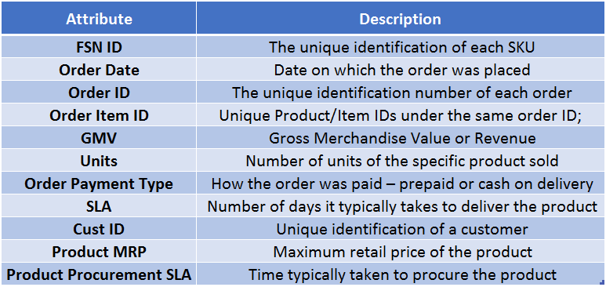
Data Understanding – Major Attributes
The data received for the analysis have 20 attributes. The important ones are -

Slide 6
Data Understanding – Additional Information
apart from consumer data following addition information received for model building
Monthly spends on various advertising channels –
Monthly spends split by various medias types such as TV, Internet, Radio and Others
Days when there was any special sale –
Information about the special sale calendar
Monthly NPS score –
Net promote score by month

Slide 7
Step by Step Approach for Analysis
Cleaning and formatting data
Derive useful metrics out of data
Check the data density and correlations
Data Scaling
Splitting the data between train and test
Data Modeling
Conclusion

Slide 8
Exploratory Data Analysis – Data Cleaning
Check for possible data inconsistencies
Check for duplicate records
Check for NA values in the columns used for analysis
Check the period of the provided data
Status of data cleaning
Around 100K records found duplicated and removed from the dataset
Around 4K removed where Gross Merchandise Value is Null
Removed the data which are not in the period used for analysis
Below columns where removed after applying Near Zero Variances
units, product_analytics_super_category
Records with orders with revenue per unit more than MRP, negative SLA or product_procurement_sla – 26186 records.
Caped the GMV accordingly (MRP*units) so we do not loose revenue as we have investment for all days in a month

Slide 9
Exploratory Data Analysis – Derived Metrics
Below the new columns derived for further analysis
Offer Percentage = ((Product MRP * Unit Sold) – Gross Merchandise Value or Revenue) divided by (Product MRP * Unit Sold)
Product MRP Class = classifying products in to three categories – premium, medium and cheap
Premium – price range more than 75 percentile in same product_analytic_vertical
Medium – price within 25 to 75 percentile in same product_analytic_vertical
Cheap – price less than 25 percentile in same product_analytic_vertical
Week Number, week number of the year ranging from 0-53 with Monday as first day of the week
Day, day of the month ranging from 0-31

Slide 10
Categorical Vs Numerical Variables
Below the list of categorical and numerical variables considered for further analysis
Categorical Variables
s1_fact.order_payment_type
product_analytic_category
product_analytic_sub_category
product_analytic_vertical
product_mrp_class
Year
Month
Numerical Variables
gmv
deliverybdays
deliverycdays
sla
pincode
product_mrp
product_procurement_sla
offer_percentage

Slide 11
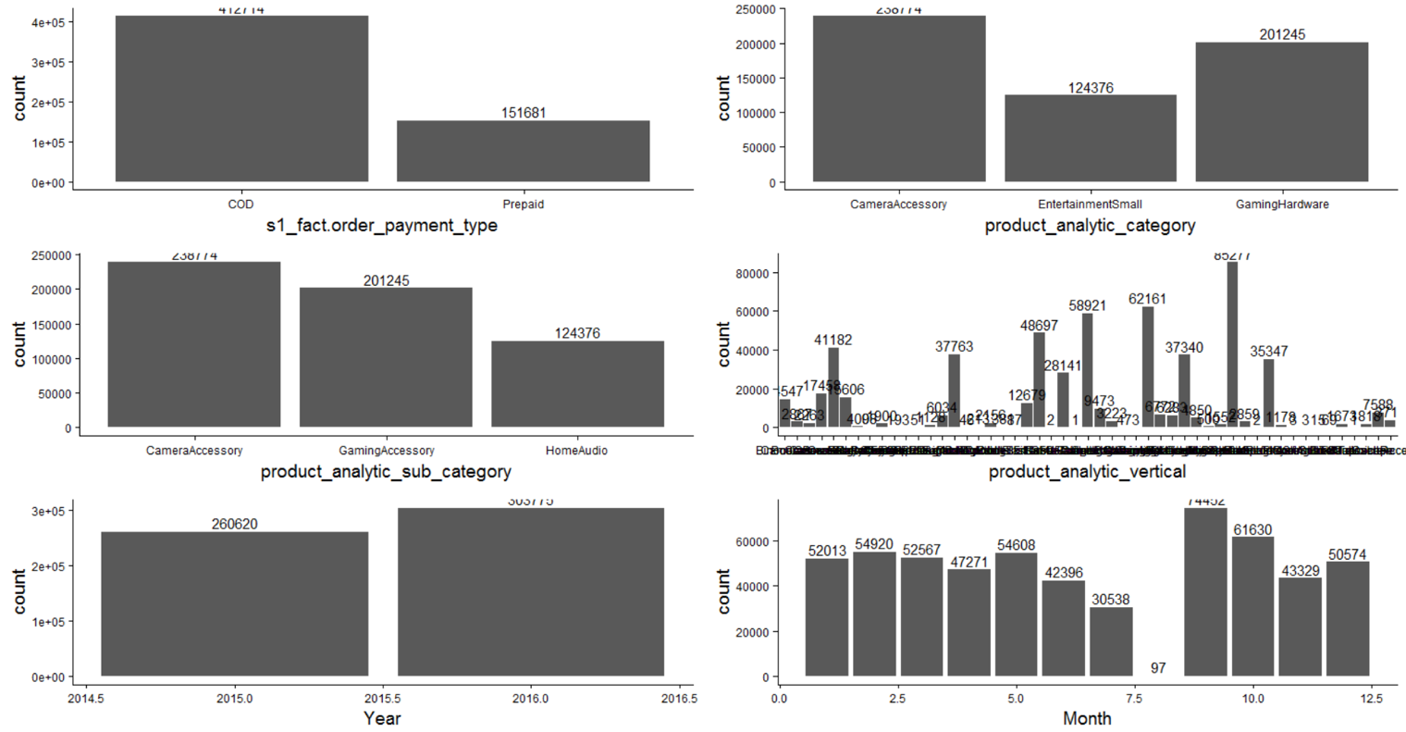
Univariate Analysis – Categorical Variables

Slide 12
Bivariate Analysis – Correlation Plot
Categories such as Gaming Hardware, Gaming Accessory, Entertainment Small and Home Audio are highly correlated

Slide 13
Bivariate Analysis – High Correlated Variable
Product_MRP showed high correlated to GMV, followed by sales of premium products

Slide 14
Boxplots of numeric variables relative to gmv

Slide 15
Aggregated Plots
Plots explains the aggregation of
different values of the Categorical Variables

Slide 16
Aggregation Strategy
Strategies applied to aggregate the data are
Aggregate By Week
Year and Week variables used to GROUP the dataset
Applied SUM function for GMV, Product MRP, Offer Price and other numerical variables
Applied MEAN* function for deliverybdays, deliverycdays, product_procurement_sla variables
Created new columns for each possible value of category (repeated across all category columns) that specifies percentage of categorical value among other values in same colums. For example, a week with 2 prepaid and 3 COD orders, aggregated columns are payment_prepaid = 2/5 and payment_cod = 3/5
*since these variables are represents the number of days applying SUM function is not logical hence used MEAN function

Slide 17
Weekly Analysis

Slide 18
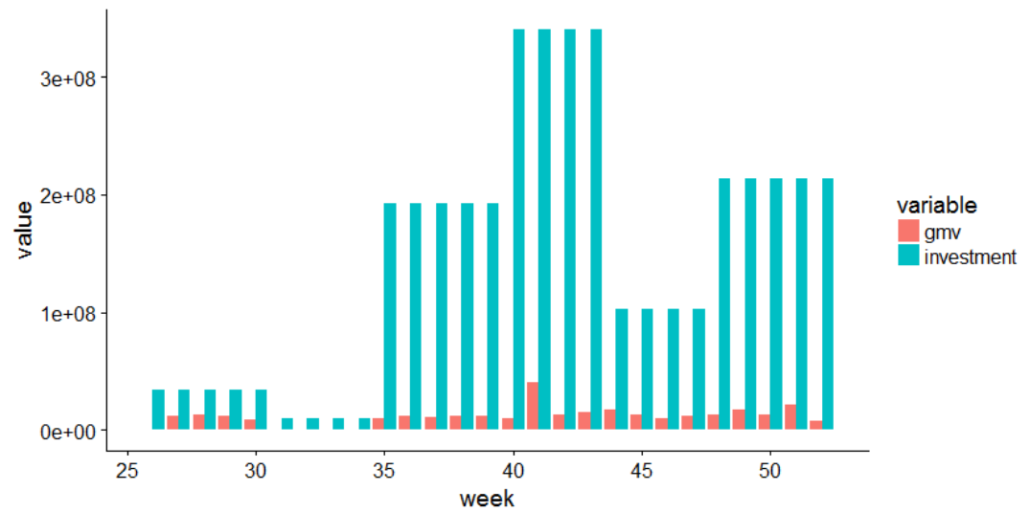
Weekly Analysis, 2015 – Revenue Vs Investments
Weekly Revenue vs. Investments Analysis from July – Dec 2016 (Week# 26-52)

Slide 19
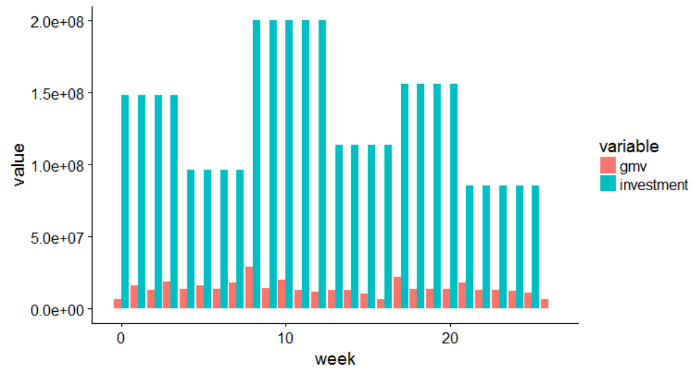
Weekly Analysis, 2016 – Revenue Vs Investments
Weekly Revenue vs. Investments Analysis from Jan – Jun 2015 (Week # 0-25)

Slide 20
Weekly Analysis, High Correlated Variables
Seems TV, Digital, sponsorship, Content Marketing, Affiliates and SEM are highly correlated with Gmv
Highly correlated variables with Investments

Slide 21
Modelling

Slide 22
Models Attempted
Linear Regression
Multiplicative – Log of the whole dataset is regressed with the independent variable’s log
Kyock – Linear model but with one previous week of Marketing variables
Distributed Lag - Linear model but with last 3 weeks of Marketing variables (3 additional variable for each channel ex -1 week of TV channel investment, -2 week and -3 week)
Multi distributed Lag – Hybrid Model – Hybrid of 2nd and 4th model. Take last weeks variable but with log

Slide 23
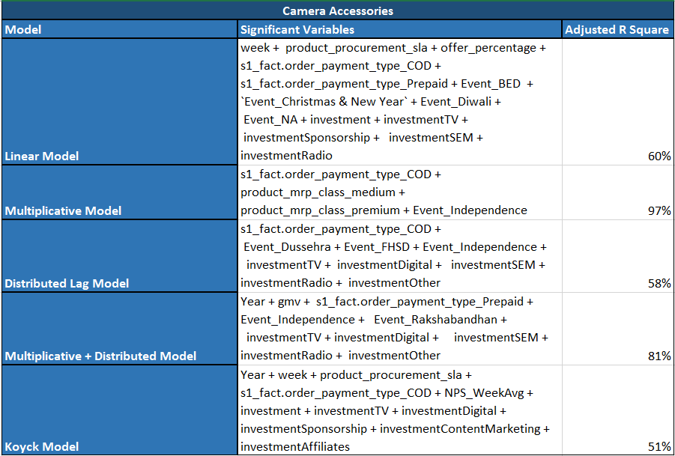
Camera Accessories - Models
For Camera Accessories, we would like to go with Multiplicative model which has an adjusted R2 of 97%

Slide 24
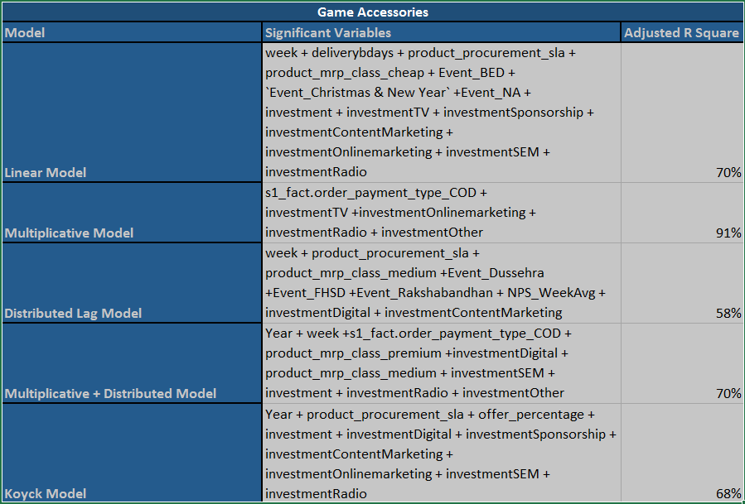
Gaming Accessories - Models
For Gaming Accessories, we would like to go with Multiplicative model which has an adjusted R2 of 91%

Slide 25
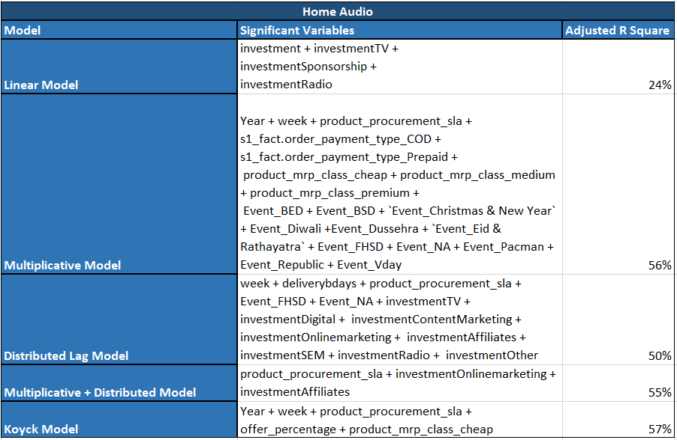
Home Audio - Models
For Home Audio, we would like to go with Kyock model which has an adjusted R2 of 57%

Slide 26
Thanks
Merin Jose
Suresh Balla
Deepak Aneja
Fayiz Mayam Veettil

